Slide 1









SafeRoute AI: Real-Time,
Congestion-Aware Evacuation
Evacuation is a coordination problem—not a lack of exits.
Coordinates Crowds
Prevents bottlenecks before they form
Stable Guidance
Works under imperfect data & partial compliance
Built on AWS
Key Takeaway
Scalable, serverless, managed-service architecture
"Coordinating flow beats routing individuals."
SafeRoute AI • AWS Case Competition

Slide 2







We optimize crowd flow, not individual routes
The "Convergence" Problem vs. SafeRoute
System-level coordination prevents exit overload
Standard Nav Apps
Feature
Static Signage
Nav Apps
SafeRoute AI
Objective
Fixed egress
Shortest path
Balanced exit flow
Inputs
Floor maps
GPS / User
Live aggregate signals
EXIT A
EXIT B
EXIT C
OVERLOAD
Empty
Empty
Decision Unit
None
Individual
Central Orchestrator
SafeRoute AI
Congestion
Ignores
Reacts late
Proactive rebalance
Safety Checks
N/A
Minimal
Policy-first validation
EXIT A
EXIT B
EXIT C
Outcome
Herding
Convergence
Distributed Load

Slide 3

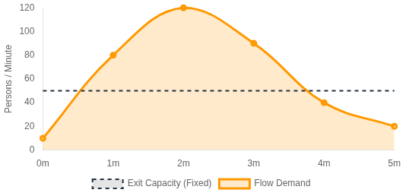
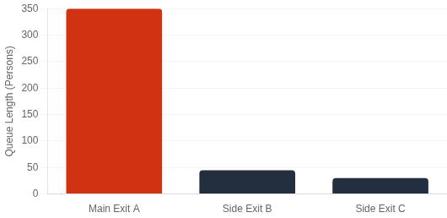


Evacuation time is dominated by bottlenecks, not distance
Queue delay outweighs travel time when demand exceeds capacity
The Physics of Delay
Why It Happens: Exit Imbalance
Queues explode when Demand > Capacity
Main entrance gets crushed while side exits sit empty
1
Most delay accrues in queues at constrained doors/stairs, not during walking.
2
Distance differences are negligible compared to minutes spent waiting in a crush.
Key Takeaway
To save lives, we must fix the bottlenecks, not just find the shortest path.
SafeRoute AI • AWS Case Competition

Slide 4

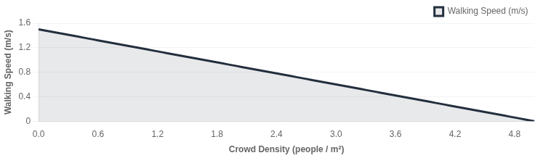








Reducing peak density causally reduces evacuation time
Crowd dynamics follow a non-linear "fundamental diagram"—speed collapses when density spikes.
Speed vs. Density Curve
Critical Threshold
Once density exceeds ~2-3 people/m², flow speed drops precipitously.
Jam Density
Non-Linear Gain
A small reduction in peak load yields a large gain in clearance speed.
Logic Chain
Redistribute Flow
Lower Peak Density
Shorter Queues
Faster Clearance
Route away from overloaded exits
Keep below critical jamming point
Minimize wait time at bottlenecks
Everyone gets out safer & sooner
Key Takeaway
Lowering the peak load drastically shortens the "long tail" of total evacuation time.
SafeRoute AI • AWS Case Competition

Slide 5


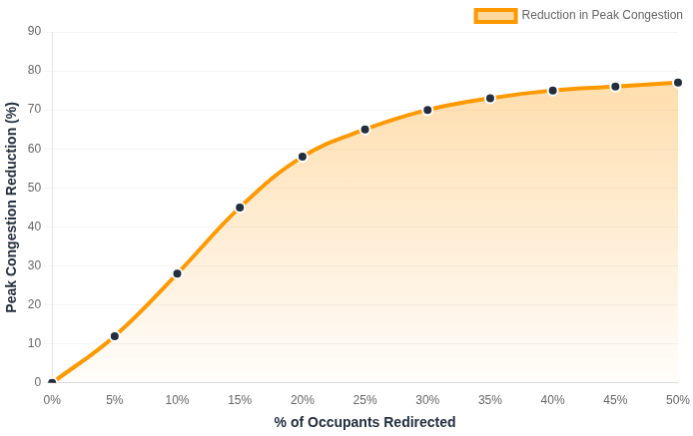






Guiding a minority still improves outcomes for everyone
Sensitivity analysis shows diminishing returns—you don't need 100% compliance to clear bottlenecks.
Impact of Redirecting Users
Simulation Data
Strategic Minority
Small, well-placed redirections ease pressure on the main exit, preventing the "crush" phase.
Optimal ROI Zone
Universal Benefit
Even non-compliant users benefit from shorter queues created by those who did reroute.
Key Takeaway
"Partial compliance is enough to decongest peaks."
At >30% redirection, margin gains decrease as secondary routes begin to fill up.
SafeRoute AI • AWS Case Competition

Slide 6






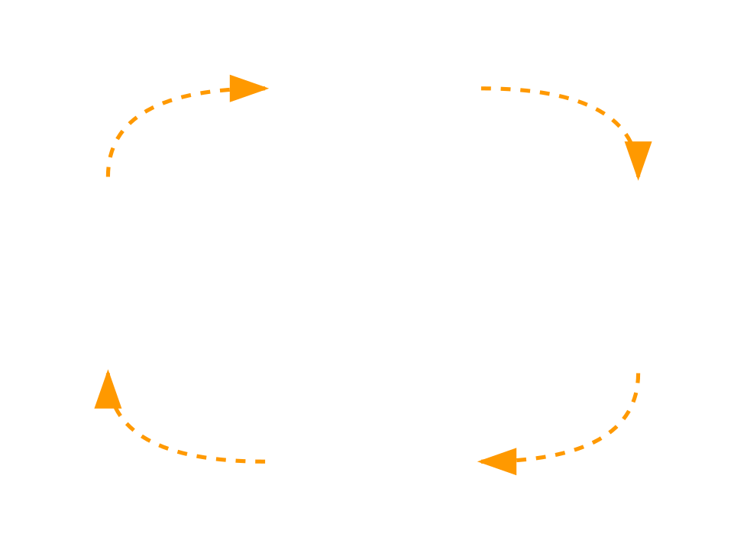








Continuous coordination loop with stable guidance
An intelligent agent orchestrates the crowd by constantly observing and conservatively updating routes.
End-to-End Data Pipeline
Phones
Crowd State
Agent
Planning
Guidance
Raw Signals
Density/Flow Est.
Orchestrator
Safety Checker
Notifications
The Coordination Cycle
1
Robust to Noise
Operates under imperfect data and partial compliance. The system doesn't need to know where everyone is, just the aggregate flow.
Observe
2
Stability First
Prioritizes clarity over churn. We avoid confusing users with constantly changing instructions unless safety is critical.
Guide
Guardrails
Assess
Conservative Updates
Anti-Flip-Flop
Plan
Key Takeaway
"Simple loop, conservative updates, clear guidance."
SafeRoute AI • AWS Case Competition

Slide 7
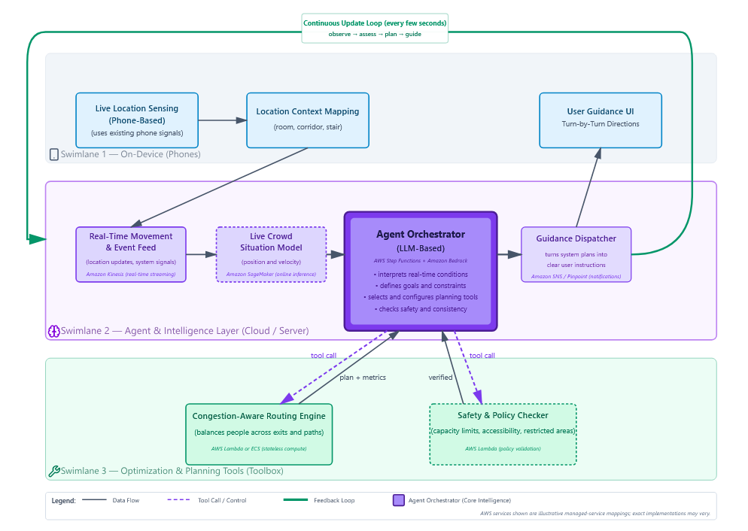
Buildable today using AWS managed services
Serverless, event-driven architecture that scales with crowd size without deep infrastructure management.

Slide 8









Measurable improvements via drills and pilots
Quantifying safety gains through controlled A/B testing scenarios and simulation.
Target Key Performance Indicators
Simulation Targets
Evaluation Plan
Metric
Trend
Safety Impact
1
Baseline Drill
Faster full evacuation
Standard evacuation (static signage). Measure queues.
Total Clearance Time
2
SafeRoute-Enabled
Peak Bottleneck Density
Prevents crush injuries
Activate Agent. Push guidance to users. Record telemetry.
Optimizes building egress
3
Compare KPIs
Exit Utilization Balance
Analyze delta in clearance time and density vs baseline.
Hotspot Duration
Reduces exposure time
4
Iterate & Tune
Better situational awareness
Refine Agent constraints based on observed friction.
Operator Visibility
Causal Validation: Prove bottleneck relief shortens time.
Low Risk: Incremental testing in single-building MVP.
Key Takeaway
We move from "guessing" safety to empirically measuring and improving flow dynamics.
SafeRoute AI • AWS Case Competition
*KPIs based on simulation models

